Slide 1



Financial Literacy
Project
Pradhan Mantri Jan Dhan Yojna

Slide 2




Why savings are needed?
To buy something which we cannot afford from regular income.
To meet unexpected expenses like illness, accident, death, calamity
To meet larger expenses like purchasing own house, higher education
To meet our needs in old age or when are not able to earn.
Why Save in a Bank?
Safety
Money kept at home in a box, under the mattresses or even in purses can be stolen/ damaged . It can also be lost during natural calamities like floods, etc. while in the bank money is safer.
Growth
We receive interest on the money kept in the bank account. This helps our money to grow. Money kept at home cannot grow.
Loans
On the basis of our savings, fixed deposits or recurring deposits, bank can give us loans for our needs like buying a house or for education etc. .

Slide 3

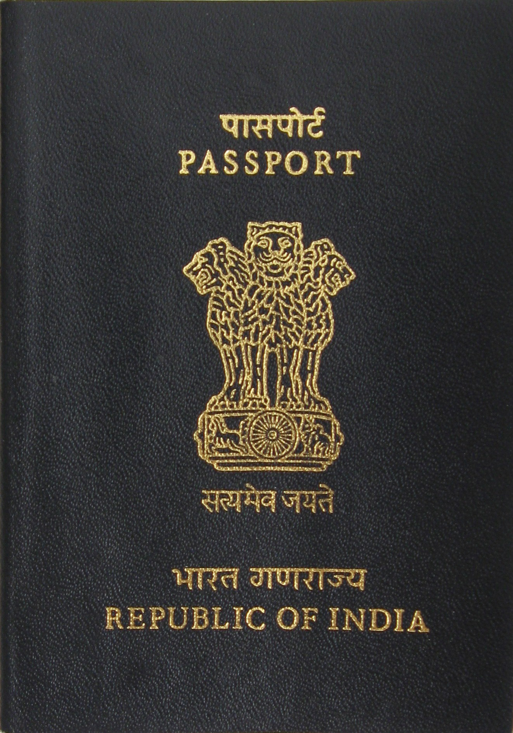
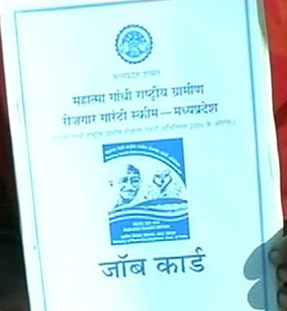
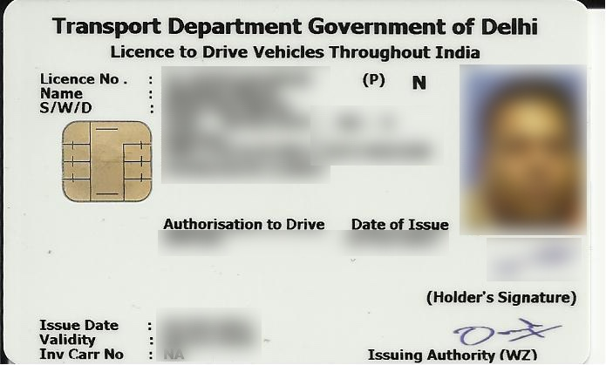
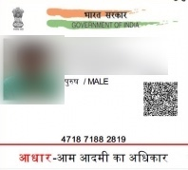
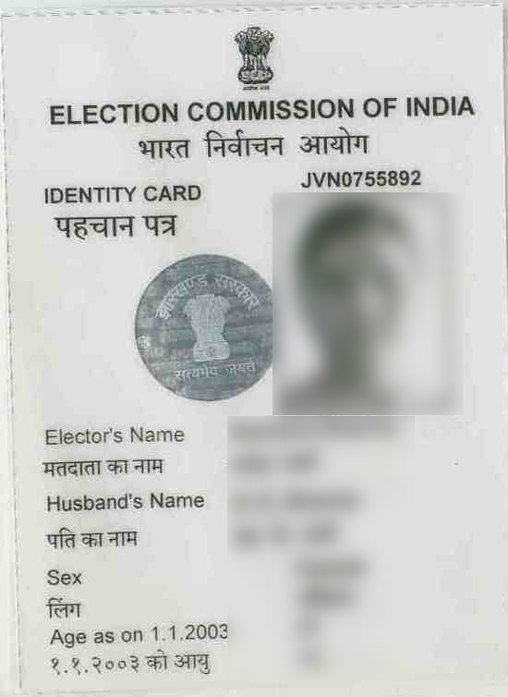
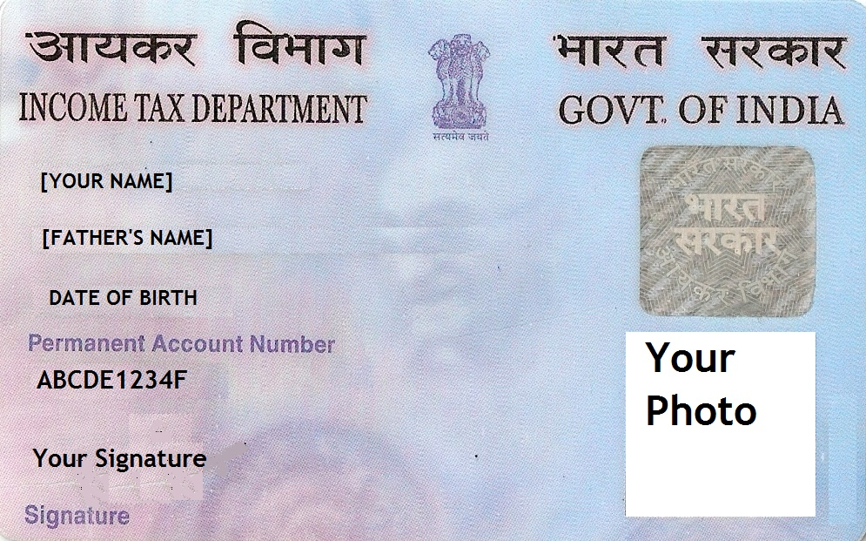
Know Your Customer (KYC)
KYC is a process to obtain information about the identity and address of the customers by the bank while opening account.
Officially Valid KYC Documents are : a) Passport, b) Driving Licence, c) Voters’ Identity Card, d) PAN Card, e) Aadhaar Card, f) MNREGA Card.
If these documents also contain the address details, then it would be accepted as ‘proof of address’ also.
1
2
3
Passport
MNREGA
Driving License
Photograph
Aadhar Card
Pan Card
Voter ID Card
In case of no official documents -
“Small Accounts” can be opened by submitting recent photograph and putting signature or thumb impression in the presence of Bank Official with certain conditions.
Fresh KYC Documents to be submitted on attaining majority, i.e. 18 years in case of minor accounts

Slide 4
Types of Accounts?
Savings Bank Account
flexibility in deposits and withdrawal of funds from the account.
Passbook, ChequeBook, ATM cum Debit Card are issued to customers.
Interest is earned on the amount deposited.
Current Account
Current accounts are opened in the names of firm / company .
No limits for number of transactions.
No interest is paid by Banks on these accounts.
Recurring Deposit Account
Periodic deposit of money for a fixed period.
Interest paid on RD accounts is higher than savings A/c
Withdrawal is permitted on maturity or pre-mature closure of account.
Term Deposit / Fixed Deposit
Term Deposits are for fixed tenure from 7 days to 10 yrs.
Banks pay higher interest rates on Term deposits.
Interest can be withdrawn at monthly/ quarterly intervals or cumulated .
Small Accounts
‘Small Account’ can be opened by submitting recent photograph and putting signature or thumb impression in the presence of the Bank official. Valid for 12 Months
Balance in accounts at any point of time should not exceed Rs.50,000
Basic Savings Bank Deposit Account
There is no requirement of minimum balance.
Facility of Debit card.
Any individual above the age of 10 years can open BSBD Account.

Slide 5
Services
The Bank transfers our money from one place to another and from person to person safely, speedily and efficiently.
Can be done at Branch, Bank Mitra with Micro ATM, Internet Banking, Mobile Banking, NEFT & RTGS.
Remittances
Mobile Banking
Fund transfer NEFT/ RTGS, , IMPS & Bill payment
Accepted at all ATMs for cash withdrawal and at PoS machines (for making cashless payment for purchases).
Personal Identification Number (PIN) is used at the time of withdrawal of money from ATM & transaction at PoS.
PIN should be changed at frequent intervals and should never be shared with anyone.
ATM Card can also be issued to illiterate customers.
RuPay Debit Card is an indigenous domestic debit card introduced by National Payment Corporation of India (NPCI) with in built accidental insurance of Rs. 1.00 Lacs.
ATM Card
Internet Banking
Internet Banking is an electronic payment system.
Provides facility of Fund Transfer, Bill pay, account enquiry, Ticket Booking, Online Shopping.
Banks provide loans for purchase of Home, car household goods, for Education, etc.
Loans are also provided for economic activities like Agriculture, Business, Industry and service sector.
Loans are not provided for unlawful activities like gambling.
The rate of interest on Bank loans is very low as compared to money lenders.
Loan
Overdraft
Excess money overdrawn up to a sanctioned limit.
Pension
Assured Pension of Rs.1000 - 5000 (18 - 40 years) under Atal Pension Yojana.

Slide 6

Social Security Schemes
Pradhan Mantri Jan-Dhan Yojana
Pradhan Mantri Jan-Dhan Yojana (PMJDY) was launched by Hon’ble Prime Minister on 28th August 2014.
The scheme focuses on coverage of households in rural and urban areas by opening bank account.
A minor above the age of 10 years can open his / her Savings Bank account in any Bank.
RuPay Debit Card provides in-built Accidental Insurance Cover of Rs.1.00 lac without any charge to the customer.
To get benefit of Accidental Insurance Cover, RuPay Debit Card must be used at least once every 45 days.
Overdraft facility up to Rs.5000/- is available to one account holder in a family after 6 months of satisfactory conduct of the account.
Pradhan Mantri Suraksha Bima Yojana
PMSBY, an Accident Insurance Scheme provide accidental death and disability cover to account holders on accident upto Rs. 2.00 Lacs .
All Savings Bank account holders in the age 18 to 70 years are eligible for scheme with the premium of Rs.12/ annum/ member renewable every year.
Pradhan Mantri Jeevan Jyoti Bima Yojana
PMJJBY, an Insurance Scheme for life insurance cover of Rs. 2.00 Lacs for death due to any reason.
Available at Bank branches/ Bank Mitr
All saving Bank account holders in the age 18 to 50 years are eligible for this.
The premium is Rs.330 plus service tax/ annum/ member. . Renewable at yearly intervals

Slide 7

Social Security Schemes
Pradhan Mantri Mudra Yojana
The Hon’ble Prime Minister launched Mudra and Pradhan Mantri Mudra Yojana (PMMY) on 08.04.2015
To provide formal access of financial facilities to Non – Corporate Small Business Sector (NCSBS).
To promote & ensure bank finance to the unfunded segments of the economy such as small manufacturing units, shopkeepers, fruits / vegetable vendors, truck & taxi operators, food service units, repair shops, small industries, artisan’s food processors, street vendors and many others.
Categories of Loan
Shishu
Upto Rs.50,000/-
Kishore
Rs.50,000 – 5 Lakh
Tarun
Rs.5 lakh – 10 Lakh
Free from collateral security
No processing fee & margin money for Shishu Loan
Any Indian Citizen who has a business plan for a non-farm sector income generating activity such as manufacturing, processing, trading or service sector and whose credit need is less than 10 lakh .
MUDRA Card will be a RuPay Debit Card which will provide a facility of working capital arrangement in the form of OD, it can be used at ATM, Bank Mitra & PoS.

